Slide 1
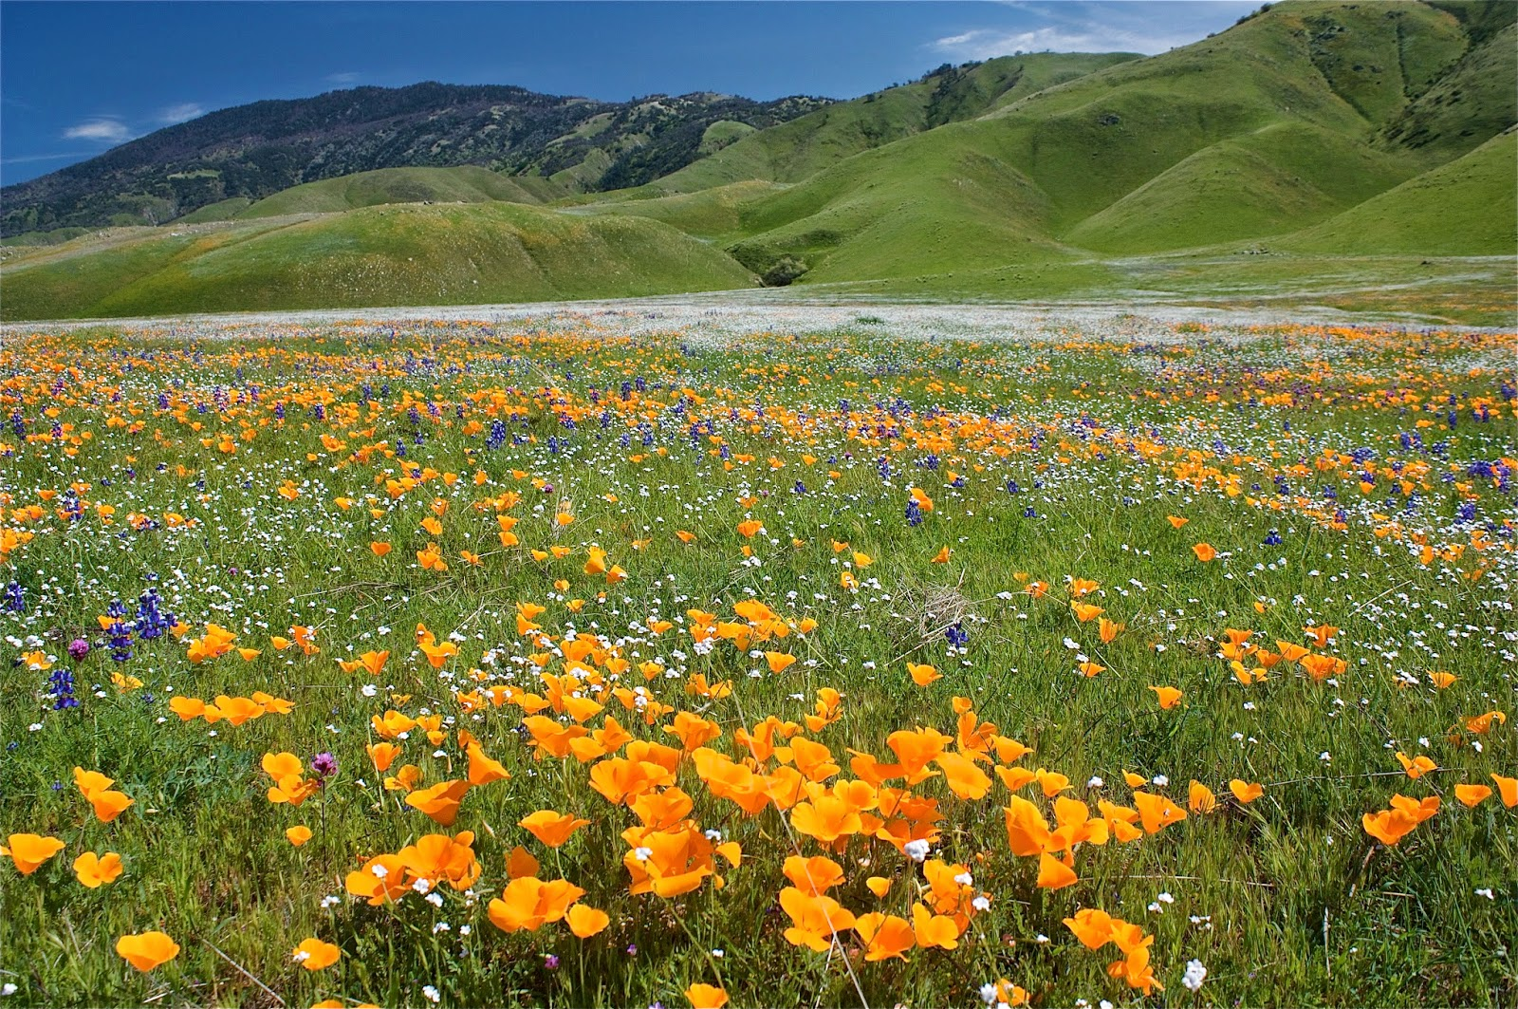
State Change in California Annual Grasslands

Slide 2
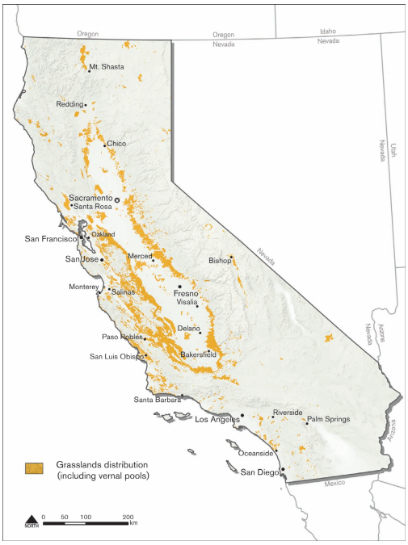
Introduction to California Annual Grasslands
California Grasslands:
Cover more than 10% of the state
Economically important – ranching, agriculture, water management, other ecosystem services…
Natural History:
Former dominance of perennial bunchgrasses (?)
Introduction + naturalization of annual forage species
Recent prominence of several invaders
Temporal dynamics:
Difficult to predict what species will appear in a given year, but valuable to do so
Thought to be governed by several key dynamics:
Fecundity, seed limitation, and interactions at the seedling stage
Priority effects and persistence
Water limitation and drought stress

Slide 3
Conceptualizing Turnover
Species-specific patterns can be messy at small scales
State-transition models find discrete “states” that best define the total variation in vegetation types.
History of use in rangeland management:
Strong links between vegetation and soil characteristics
State assignments and transition frequencies related to environmental variables and management practices (RDM)

Slide 4
Questions re: State and Transition Models
States:
How many are there? What species define states? Reliance on expert opinions.
Transitions:
What governs transitions between states? Which states are the most stable? Can be difficult to conduct separate trials of state change.
Can provide a more quantitative assessment by:
Detecting the optimal number of states in the dataset.
Incorporating transitions between discrete states into modelling framework.

Slide 5
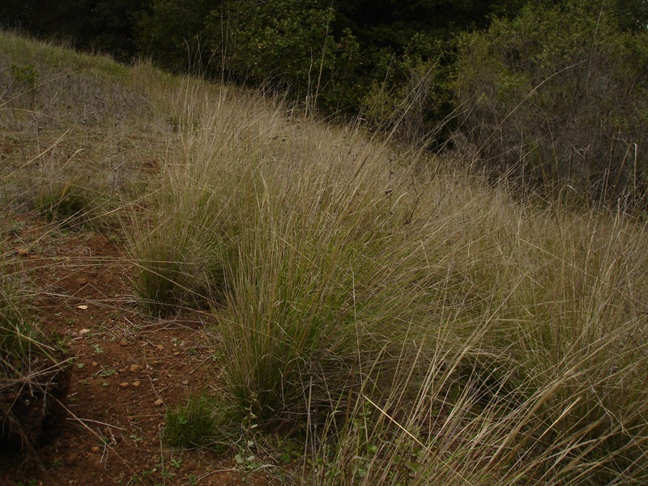
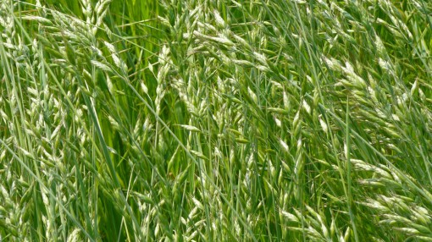
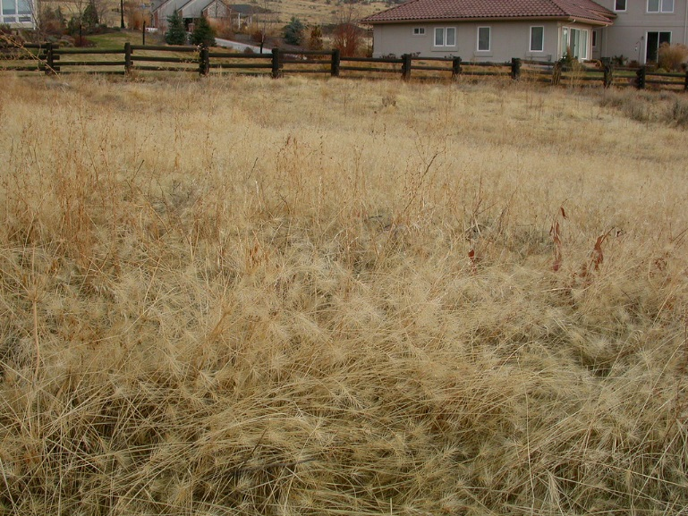
Classic models of California grasslands suggest that there are three key “states” in annual rangelands:
Native Perennials
Limited recruitment
Seed limitation
Strong competitors once established
Resilience to adverse environmental conditions
Naturalized Annuals
Strong priority effects
Large seeds, high fecundity
Variable competitive ability
Limited persistence
Small seed bank
Invasive Species
Effective invaders of annual-dominated systems
Drought sensitivity
Late phenology

Slide 6
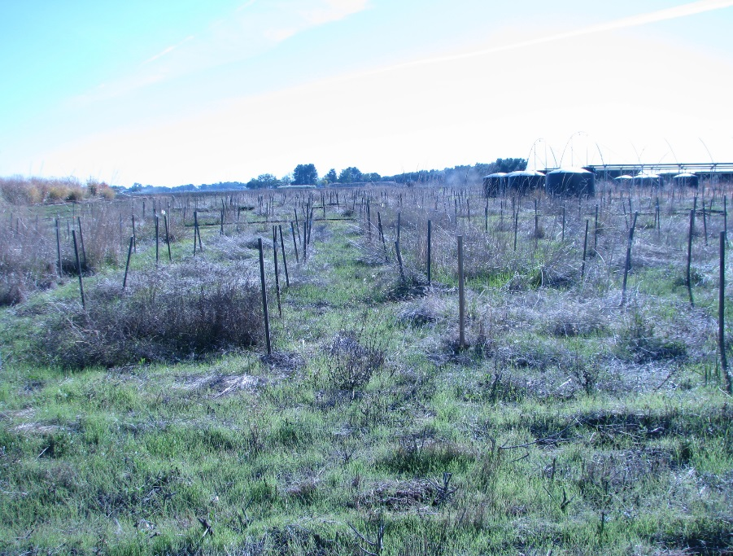
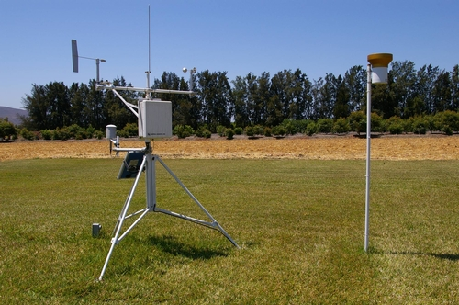
Introduction to the WAPS data:
Natives:
Nassella pulchra (syn. Stipa pulchra)
Elymus glaucus
Lotus purshianus
Leymus triticoides
Lupinus bicolor
Poa secunda
Vulpia microstachys
Naturalized Annuals:
Avena fatua
Bromus hordeacous
Lolium multiflorum
Trifolium subterraneum
Invasive Species:
Aegilops triuncialis
Taeniatherum caput-medusae
Planted in full factorial combinations
I, N, A, I+A, N+A, N+I, N+I+A
Observed consistently from 2008 to present
Measurements of plant species composition, areal cover throughout the growing season
Environmental data provided from a local CIMIS (California Irrigation Monitoring System) station

Slide 7
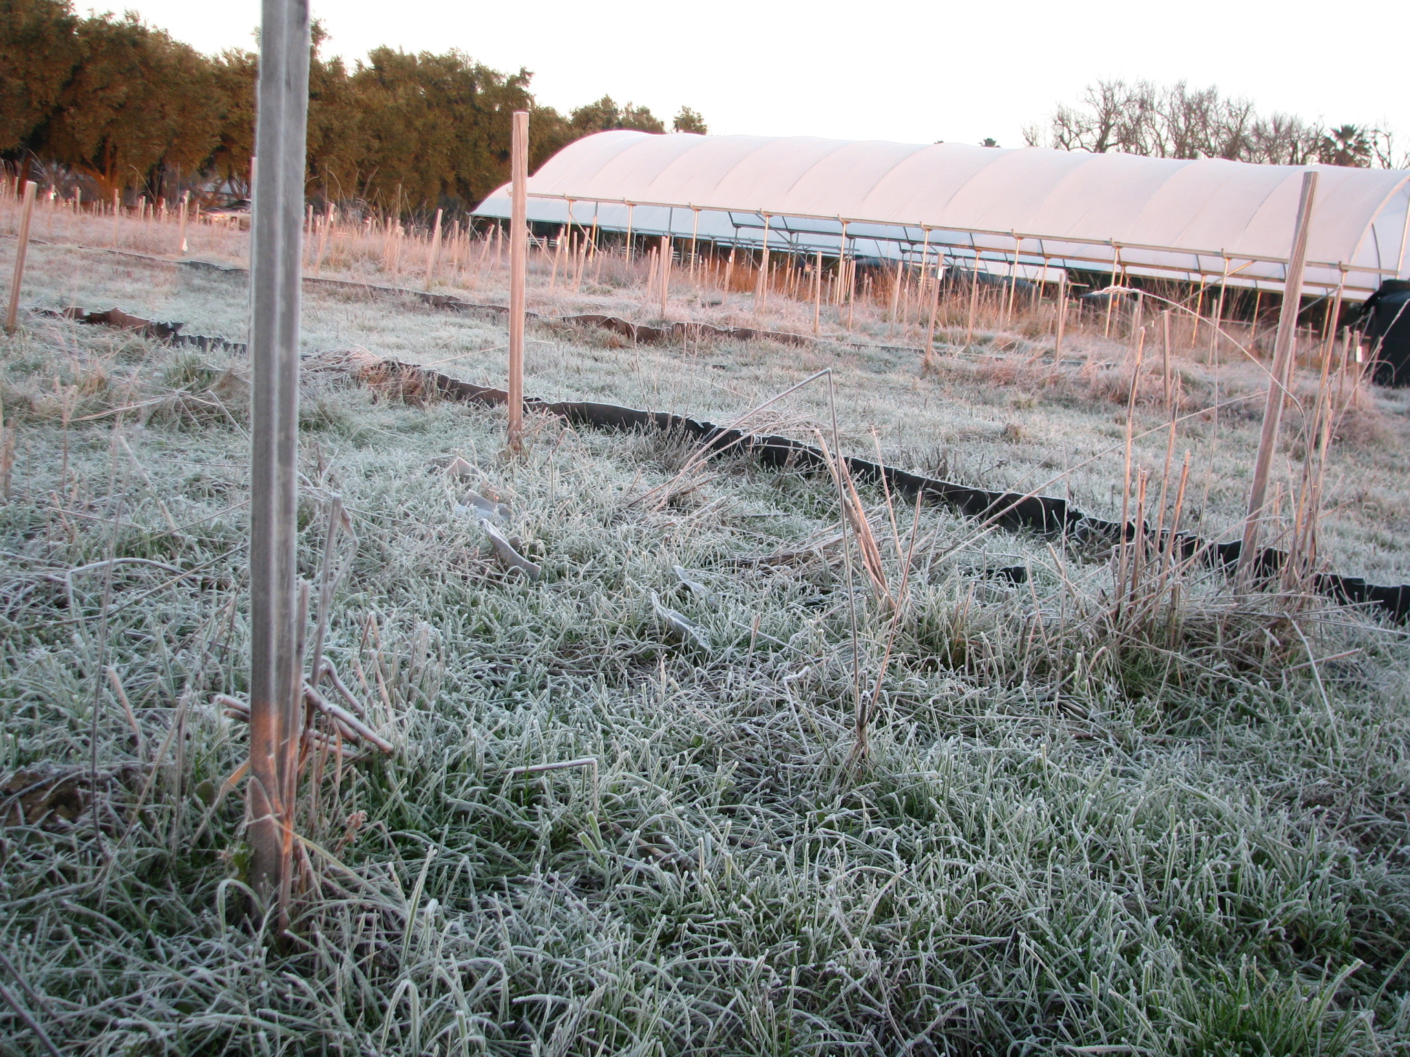
What questions can we ask with this data?
What states arise from different planting compositions?
How do state assignments vary over time?
Are transitions between states characterized by continuous, reversible changes, or non-reversible changes?
What governs transitions between states? Do planting mixtures (contingency effects) and environmental variation guide state assignments over time?

Slide 8
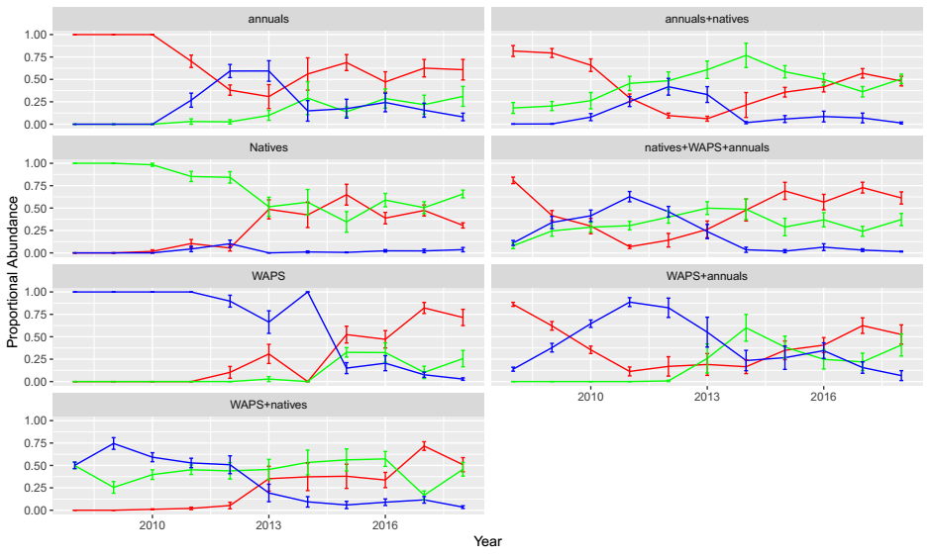
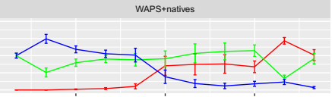
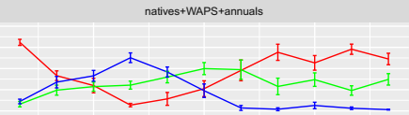
One Group Mixes
Two Group Mixes
Three Group Mix
Functional Group Proportional Abundances
Annual exotic grasses
Native perennial grasses
Invasive grasses

Slide 9
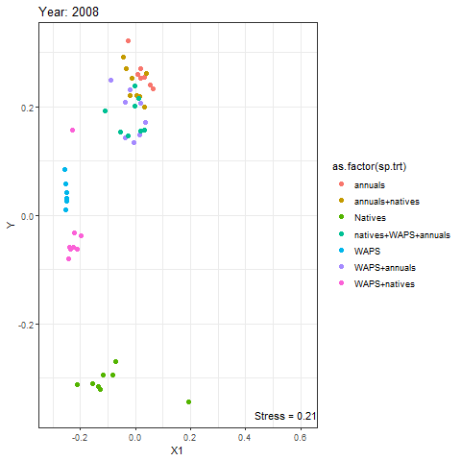
Native
Invasive
Naturalized
Native + Invasive
Native + Naturalized
Invasive + Naturalized
Native + Invasive + Naturalized

Slide 10
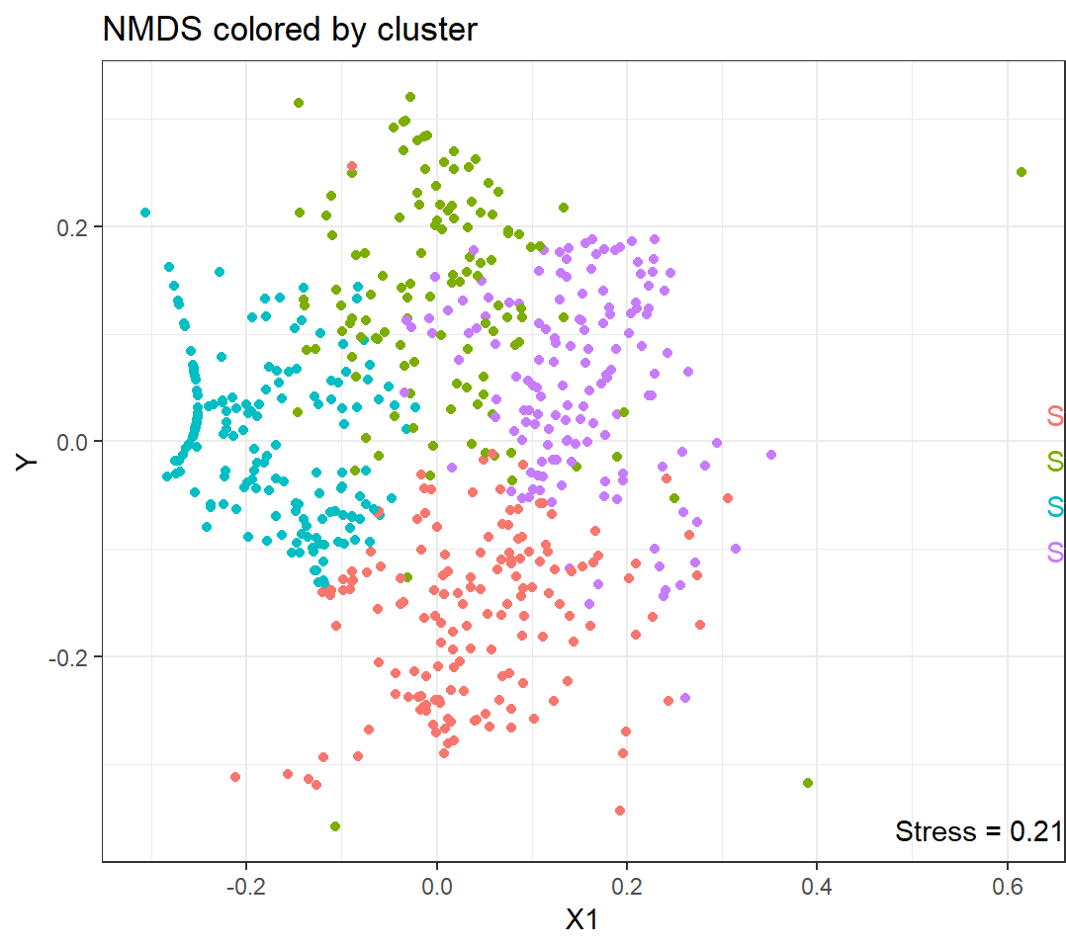
 | Species | Stat | P-Value
Grp 1 | Elymus (N) | 0.801 | 0.001
 | Nassella (N) | 0.574 | 0.001
 | bro.carinatus (N) | 0.548 | 0.001
 | Vulpia (N) | 0.284 | 0.001
Grp 2 | Lolium (E) | 0.825 | 0.001
 | Bro. hord. (E) | 0.723 | 0.001
 | Trifolium (E) | 0.607 | 0.001
Grp 3 | Taeniatherum (I) | 0.871 | 0.001
 | Aegilops (I) | 0.741 | 0.001
Grp 4 | Avena (E) | 0.819 | 0.001
 | Bro.diandrus (E) | 0.553 | 0.001
 | Leymus (N) | 0.303 | 0.036
 | Lotus (N) | 0.274 | 0.011

Slide 11
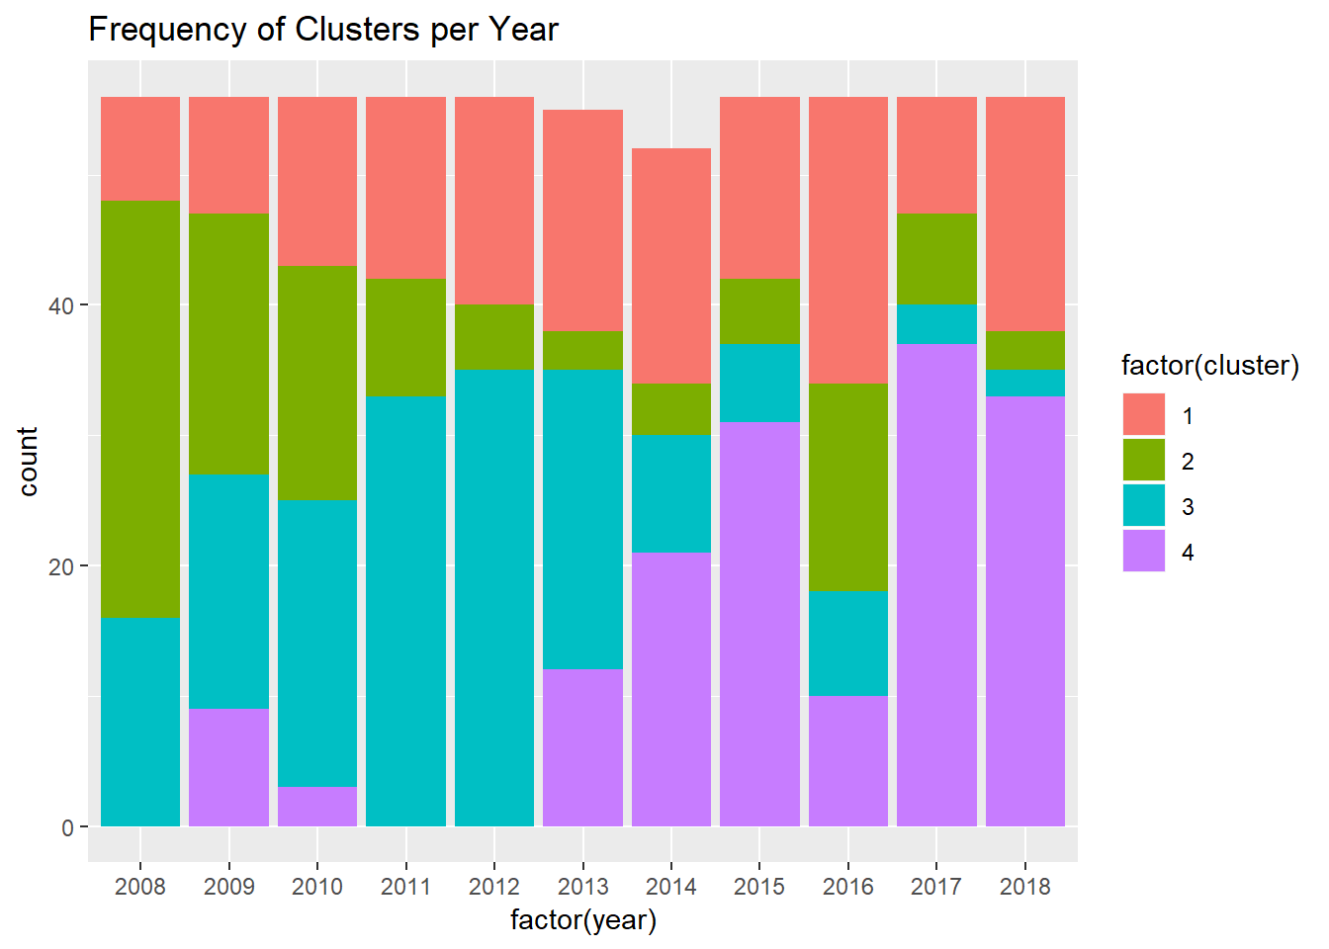
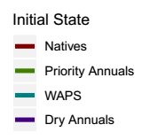

Slide 12
Fitting Markov Models
Markov models describe transitions between discrete states.
Origins (and primary use) in biostatistics
Transitions and stability of states denoted by a matrix of transition probabilities
Fit covariates to elements of this transition probability matrix
Priority: Does containing an initial planting group increase the probability of transition to this group?
Environmental Variation: Do certain transitions become more likely under different environmental conditions?
Measuring drought stress through SPEI
Standardized metric of drought stress, allows for multiscale comparisons (1, 2, and 3 year cumulative drought stress)

Slide 13
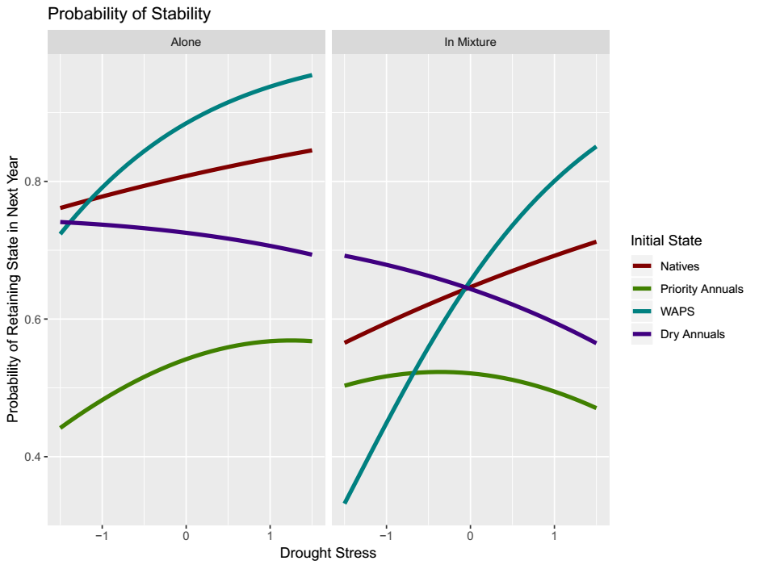

Slide 14
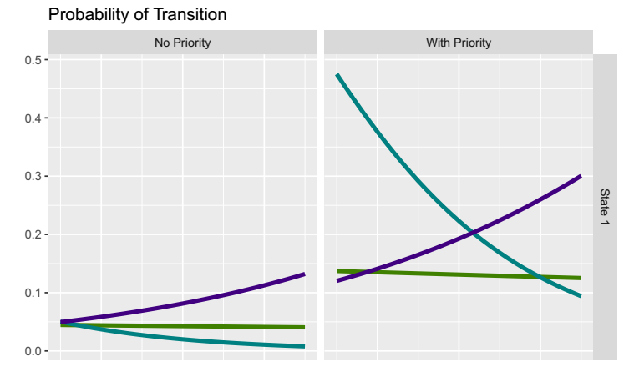
Native Species

Slide 15
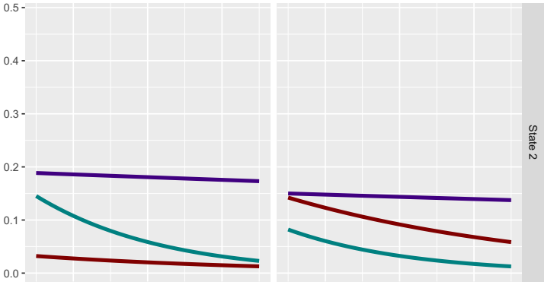
Priority Annuals

Slide 16
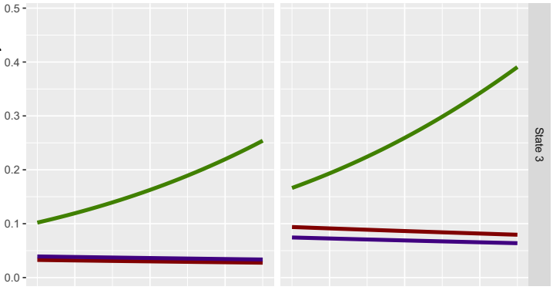
Invaders

Slide 17
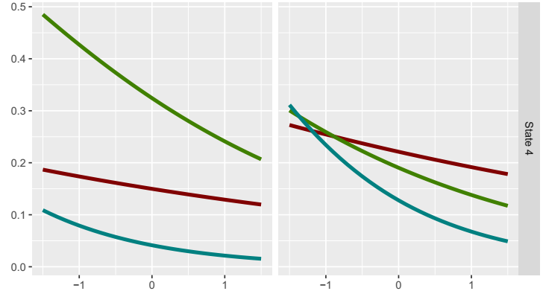
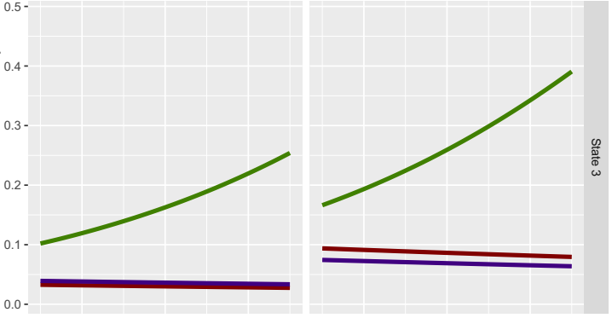
Dry Annuals

Slide 18
Key Takeaways
Separating California grassland vegetation into states based on provenance (plant origin) may fail to capture ecological function and performance.
Priority and climate act as key drivers of community turnover in California annual grasslands
Many of our hypothesized notions of invasibility, stability, etc. appear to be supported by this data:
High stability of native communities + resistance to new invaders
Some annual species quickly colonize new environments, but do not persist
New invaders are great at invading annual communities, do poorly under drought conditions
Some species appear able to capitalize on extended droughts.

